Slide 1


Nnadozie Ezenekwe
15/04/2025

Slide 2

Outline
Executive Summary
Introduction
Methodology
Results
Conclusion
Appendix

Slide 3
Executive Summary
This project focused on gathering data on Falcon 9 and Falcon Heavy launches using web scraping techniques with Beautiful Soup and the requests library. The collected data was then cleaned and analysed to determine whether a rocket’s first-stage landing was successful—a key factor in predicting launch costs. The workflow involved several steps, including Data Wrangling, Exploratory Data Analysis (EDA) with SQL and Python, and applying Machine Learning models to make landing predictions. Four classification models were tested: Logistic Regression, Support Vector Machine (SVM), Decision Tree Classifier, and K-Nearest Neighbours (KNN). The Decision Tree Classifier exhibited overfitting, while SVM and KNN delivered similar performances. Ultimately, Logistic Regression proved to be the most effective model for predicting successful landings.

Slide 4
Introduction
Falcon 9 is a two-stage, medium-lift launch vehicle developed by SpaceX in the United States. Built for partial reusability, it helps reduce spaceflight costs while delivering payloads into orbit. The rocket's first stage (booster) provides initial thrust, propelling the vehicle to a set speed and altitude before detaching. Once separated, the second stage takes over, carrying the payload to its designated orbital path. Successfully landing the first stage is essential for cost estimation, as reusable boosters make space missions more economical.

Slide 5

Section 1

Slide 6
Methodology
Executive Summary
Data collection methodology:
Describe how data was collected
Perform data wrangling
Describe how data was processed
Perform exploratory data analysis (EDA) using visualization and SQL
Perform interactive visual analytics using Folium and Plotly Dash
Perform predictive analysis using classification models
How to build, tune, evaluate classification models

Slide 7
Data Collection
Sending a request to retrieve the Falcon 9 Launch Wikipedia page using its URL
Extracting column headers from the HTML table to identify key data points
Constructing a structured data frame to store and analyze the extracted information

Slide 8
EDA with SQL
Retrieve a list of unique launch sites used in space missions.
Show five records where launch sites start with "CCA".
Calculate the total payload mass transported by boosters launched under NASA (CRS) missions.
Determine the average payload mass carried by F9 v1.1 booster version.
Identify the date of the first successful landing on a ground pad.
Find the boosters that successfully landed on a drone ship with a payload mass between 4000 and 6000 kg.
Count the number of successful and failed mission outcomes.
List all booster versions that have carried the maximum payload mass.
Extract records showing month names, failed landings on drone ships, booster versions, and launch sites for missions in 2015.Rank landing outcomes—like "Failure (drone ship)" and "Success (ground pad)"—from June 4, 2010, to March 20, 2017, in descending order.

Slide 9
Results
Exploratory data analysis results
Interactive analytics demo in screenshots
Predictive analysis results

Slide 10

Section 2

Slide 11
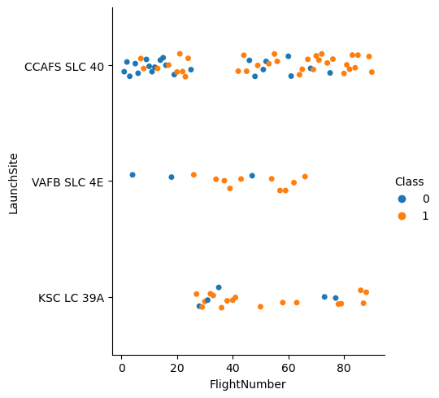
Flight Number vs. Launch Site

Slide 12
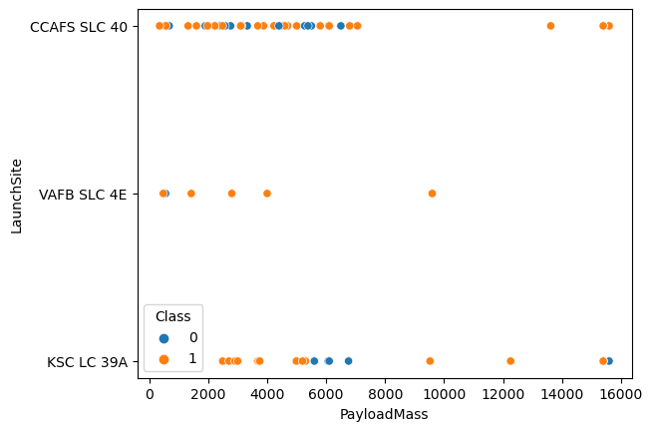
Payload vs. Launch Site

Slide 13
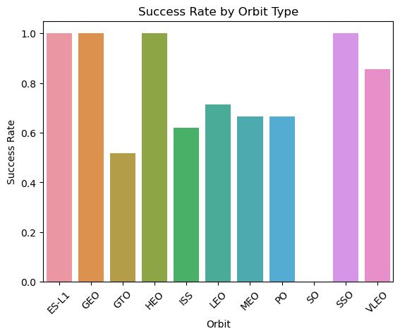
Success Rate vs. Orbit Type

Slide 14
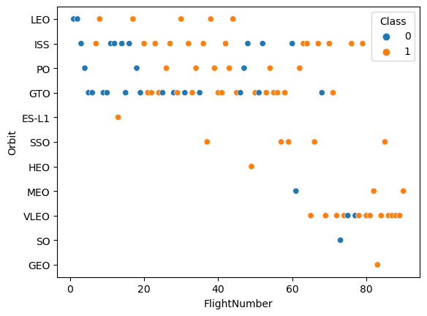
Flight Number vs. Orbit Type

Slide 15
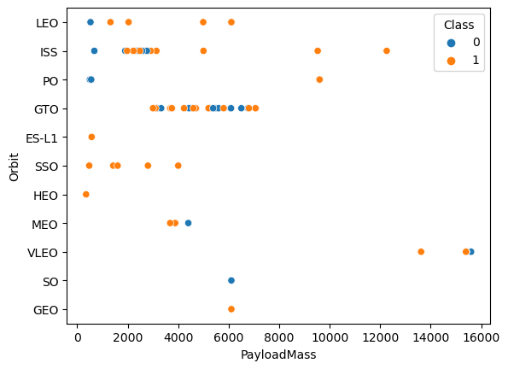
Payload vs. Orbit Type

Slide 16
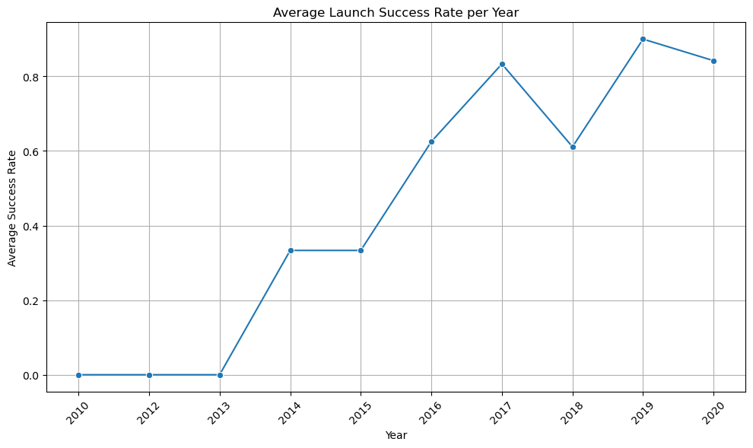
Launch Success Yearly Trend

Slide 17
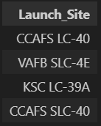
All Launch Site Names

Slide 18
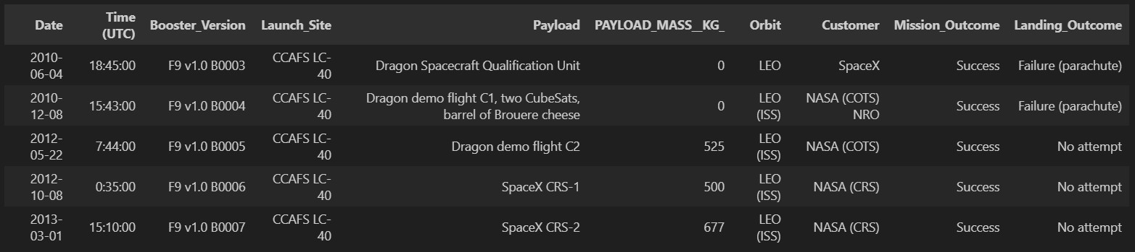
Launch Site Names Begin with 'CCA'

Slide 19
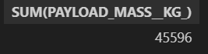
Total Payload Mass

Slide 20
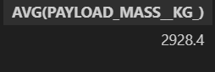
Average Payload Mass by F9 v1.1

Slide 21

First Successful Ground Landing Date

Slide 22
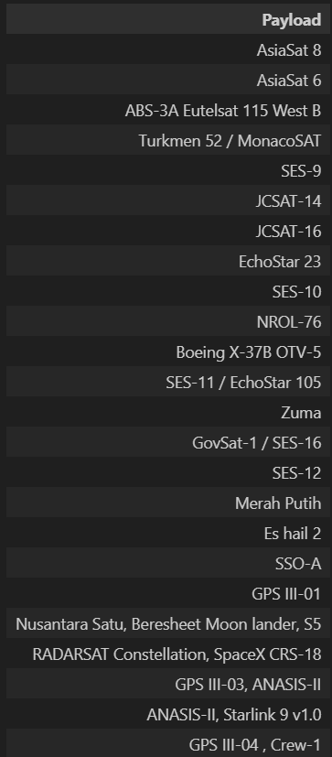
Successful Drone Ship Landing with Payload between 4000 and 6000

Slide 23

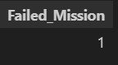
Total Number of Successful and Failure Mission Outcomes

Slide 24
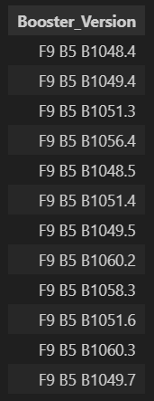
Boosters Carried Maximum Payload

Slide 25
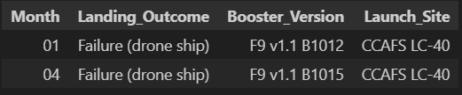
2015 Launch Records

Slide 26
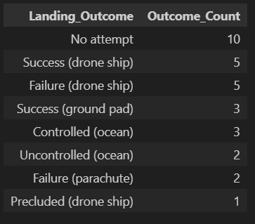
Rank Landing Outcomes Between 2010-06-04 and 2017-03-20

Slide 27

Section 3

Slide 28
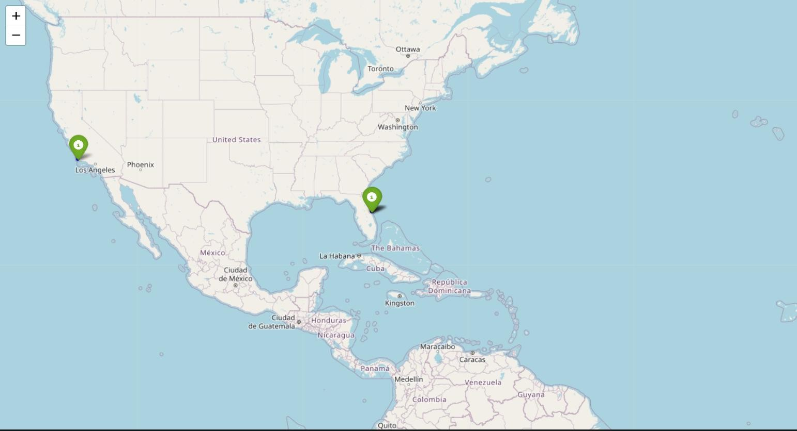
Launch

Slide 29
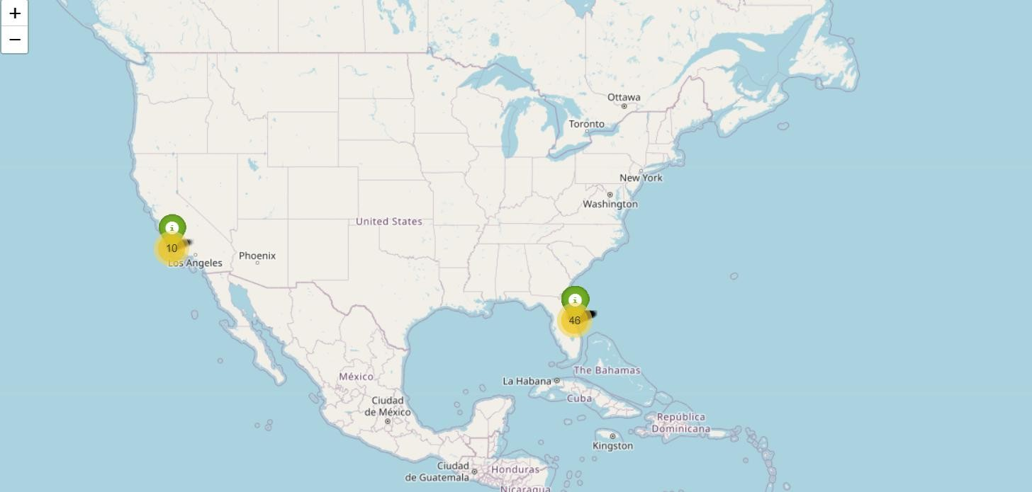
Total missions

Slide 30
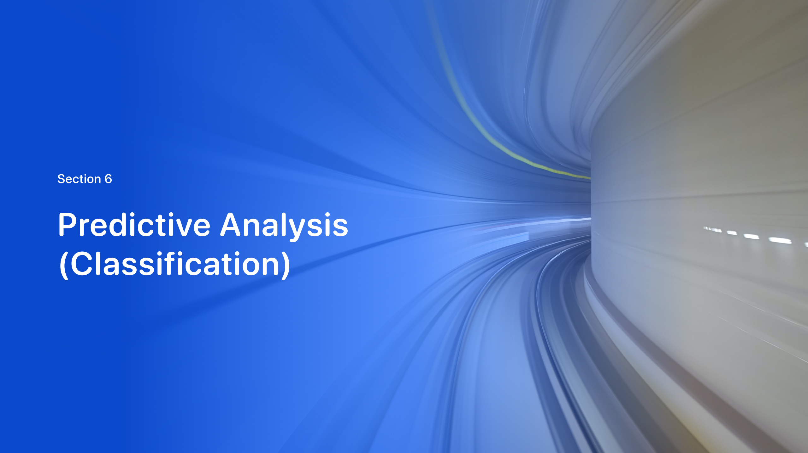
Section 5

Slide 31
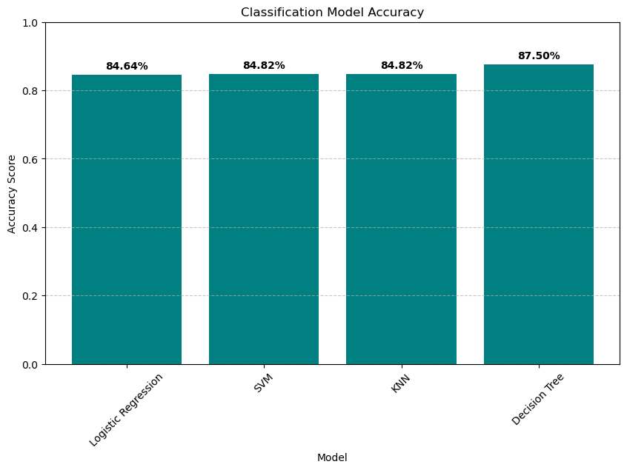
Classification Accuracy

Slide 32
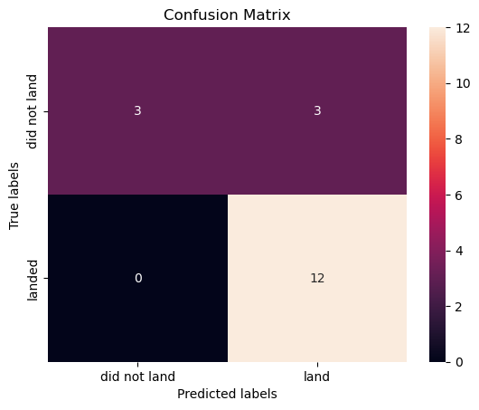
Confusion Matrix

Slide 33
Conclusions
The Logistic Regression model delivered the strongest performance in predicting outcomes. Additionally, the Falcon 9 rocket has achieved more successful missions than failed ones.

Slide 34


